Slide 1
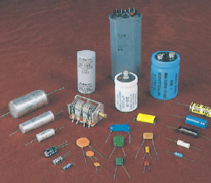
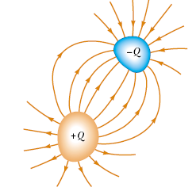
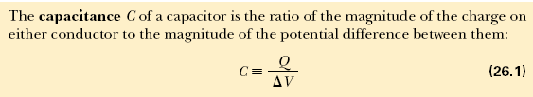
Capacitors
Capacitors—devices that store electric charge.
Capacitors are commonly used in a variety of
electric circuits. For instance, they are used to
tune the frequency of radio receivers,
as filters in power supplies,
to eliminate sparking in automobile ignition systems, and
as energy-storing devices in electronic flash units.
Consider two conductors carrying charges of equal magnitude but of opposite sign, as shown in Figure. Such a combination of two conductors is called a capacitor. The conductors are called plates. A potential difference V exists between the conductors due to the presence of the charges.

Slide 2


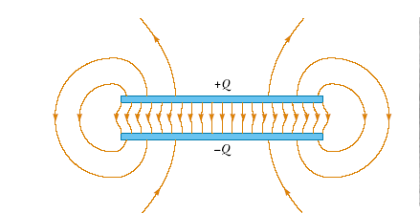



Two parallel metallic plates of equal area A are separated by a distance d, as shown in Figure. One plate carries a charge Q , and the other carries a charge Q.
The value of the electric field between the plates is

Slide 3


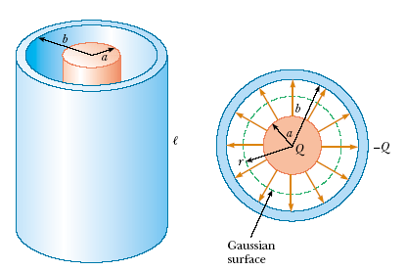



First calculate the potential difference between the two cylinders,

Slide 4


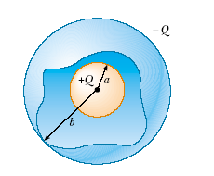




Slide 5


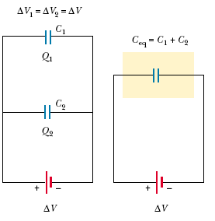



The individual potential differences across capacitors connected in parallel are all the same and are equal to the potential difference applied across the combination.

Slide 6
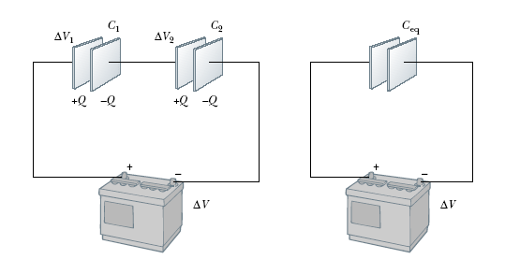






Slide 7






Suppose that q is the charge on the capacitor at some instant during the charging process. At the same instant, the potential difference across the capacitor is ΔV = q/C.
the work necessary to transfer an increment of charge dq from the plate carrying charge -q to the plate carrying charge q (which is at the higher electric potential) is

Slide 8






A dielectric is a non conducting material, such as rubber, glass, or waxed paper.
When a dielectric is inserted between the plates of a capacitor, the capacitance increases.
If the dielectric completely fills the space between the plates, the capacitance increases by a dimensionless factor κ, which is called the dielectric constant.

Slide 9

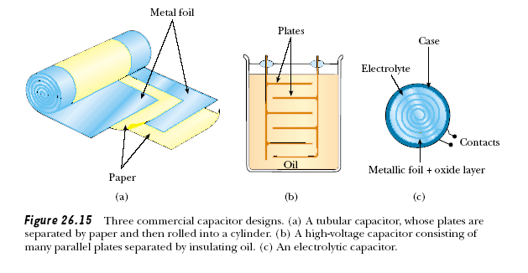


Slide 10

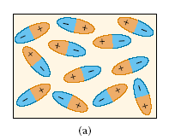
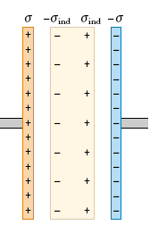
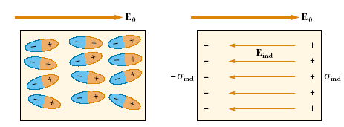
Polar molecules are randomly oriented in the absence of an external electric field.
(b) When an external field is applied, the molecules partially align with the field.

